Slide 1



Slide 2
Building in the Home with
Wellness 101
Sarah Ng

Slide 3
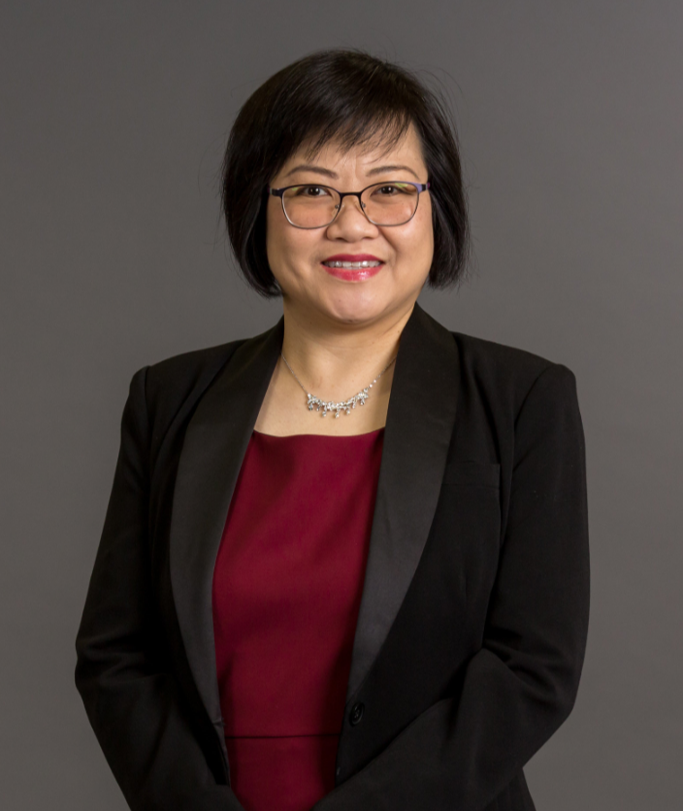
SARAH NG
Resides in Melbourne, originally from Malaysia
Kindergarten Teacher prior to SHOP.COM/Market Australia
Professional Coordinator
Melbourne English UBP Coordinator
Multiple Local Challenge winner
Shopping Annuity Master Member

Slide 4
Building in the Home with Wellness 101
Wellness
101
RETAIL TO RECRUIT
Home events are essentials
for the growth of our business
Leveraged time
Create a repeat stable customer base
Create Cash Flow
Find new business partners
Duplicable
Recruit
&
Sponsoring
Customer
&
Cash flow
Create Curiosity…
Prospecting

Slide 5
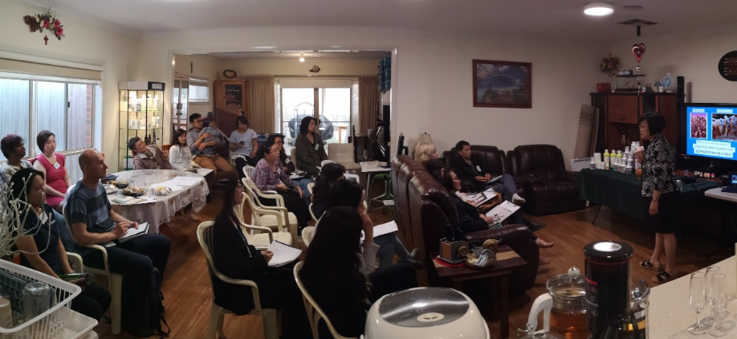
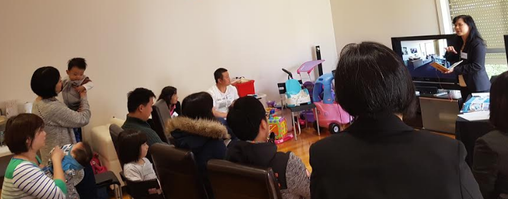
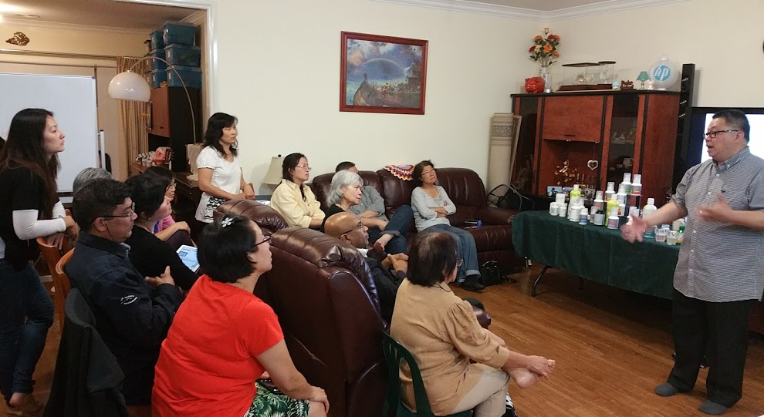
How to run
Wellness 101

Slide 6
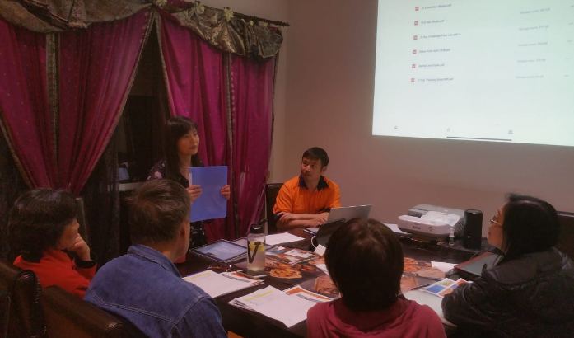
Preparation is Important…
To Be Successful,
A neat/presentable home
Children and pets – need a separate area
Big enough TV
Set up early
Be ready
Light refreshments
It’s a Team Effort

Slide 7


INVITATION
Touch on WHY?
NOT on what

Slide 8
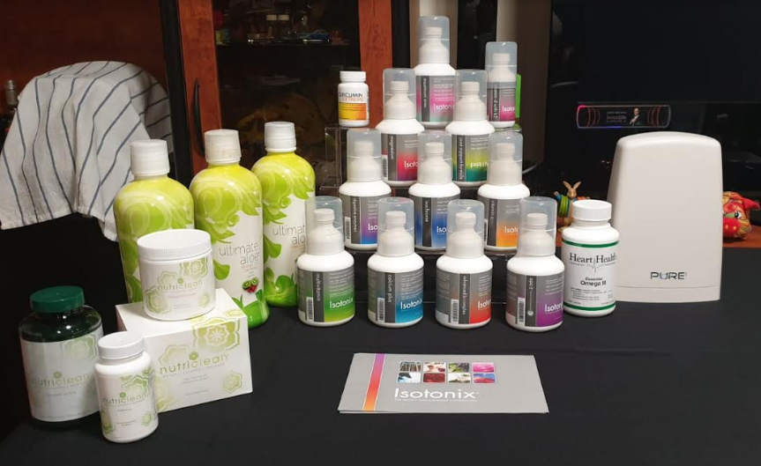
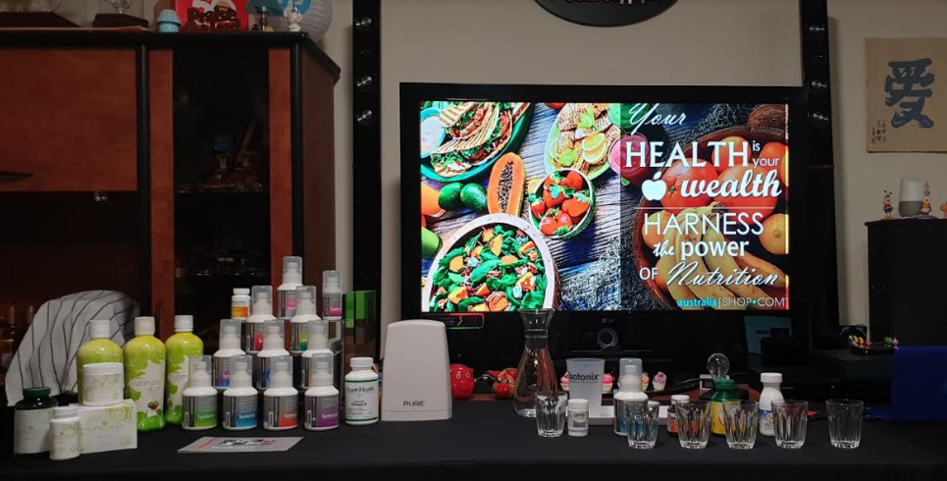
Product Display

Slide 9
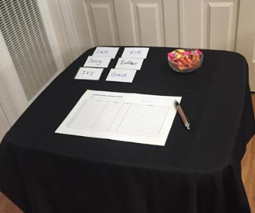
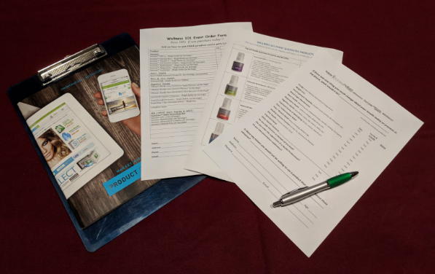
Registration Table
Name tags
Registration Form
Pen
Minties*
Clipboard 1 per customer
Health Survey Form
Product recommendation
Order Form
Catalogue
Pen

Slide 10
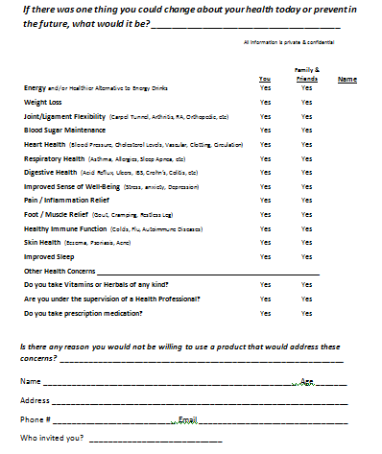
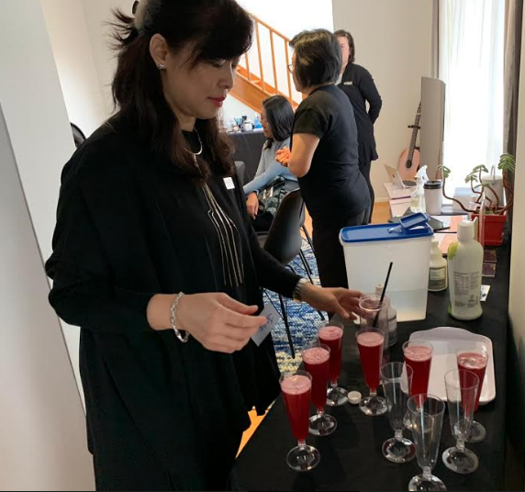
Welcome the guests with
a Drink !
Warm them up with a Health Survey

Slide 11
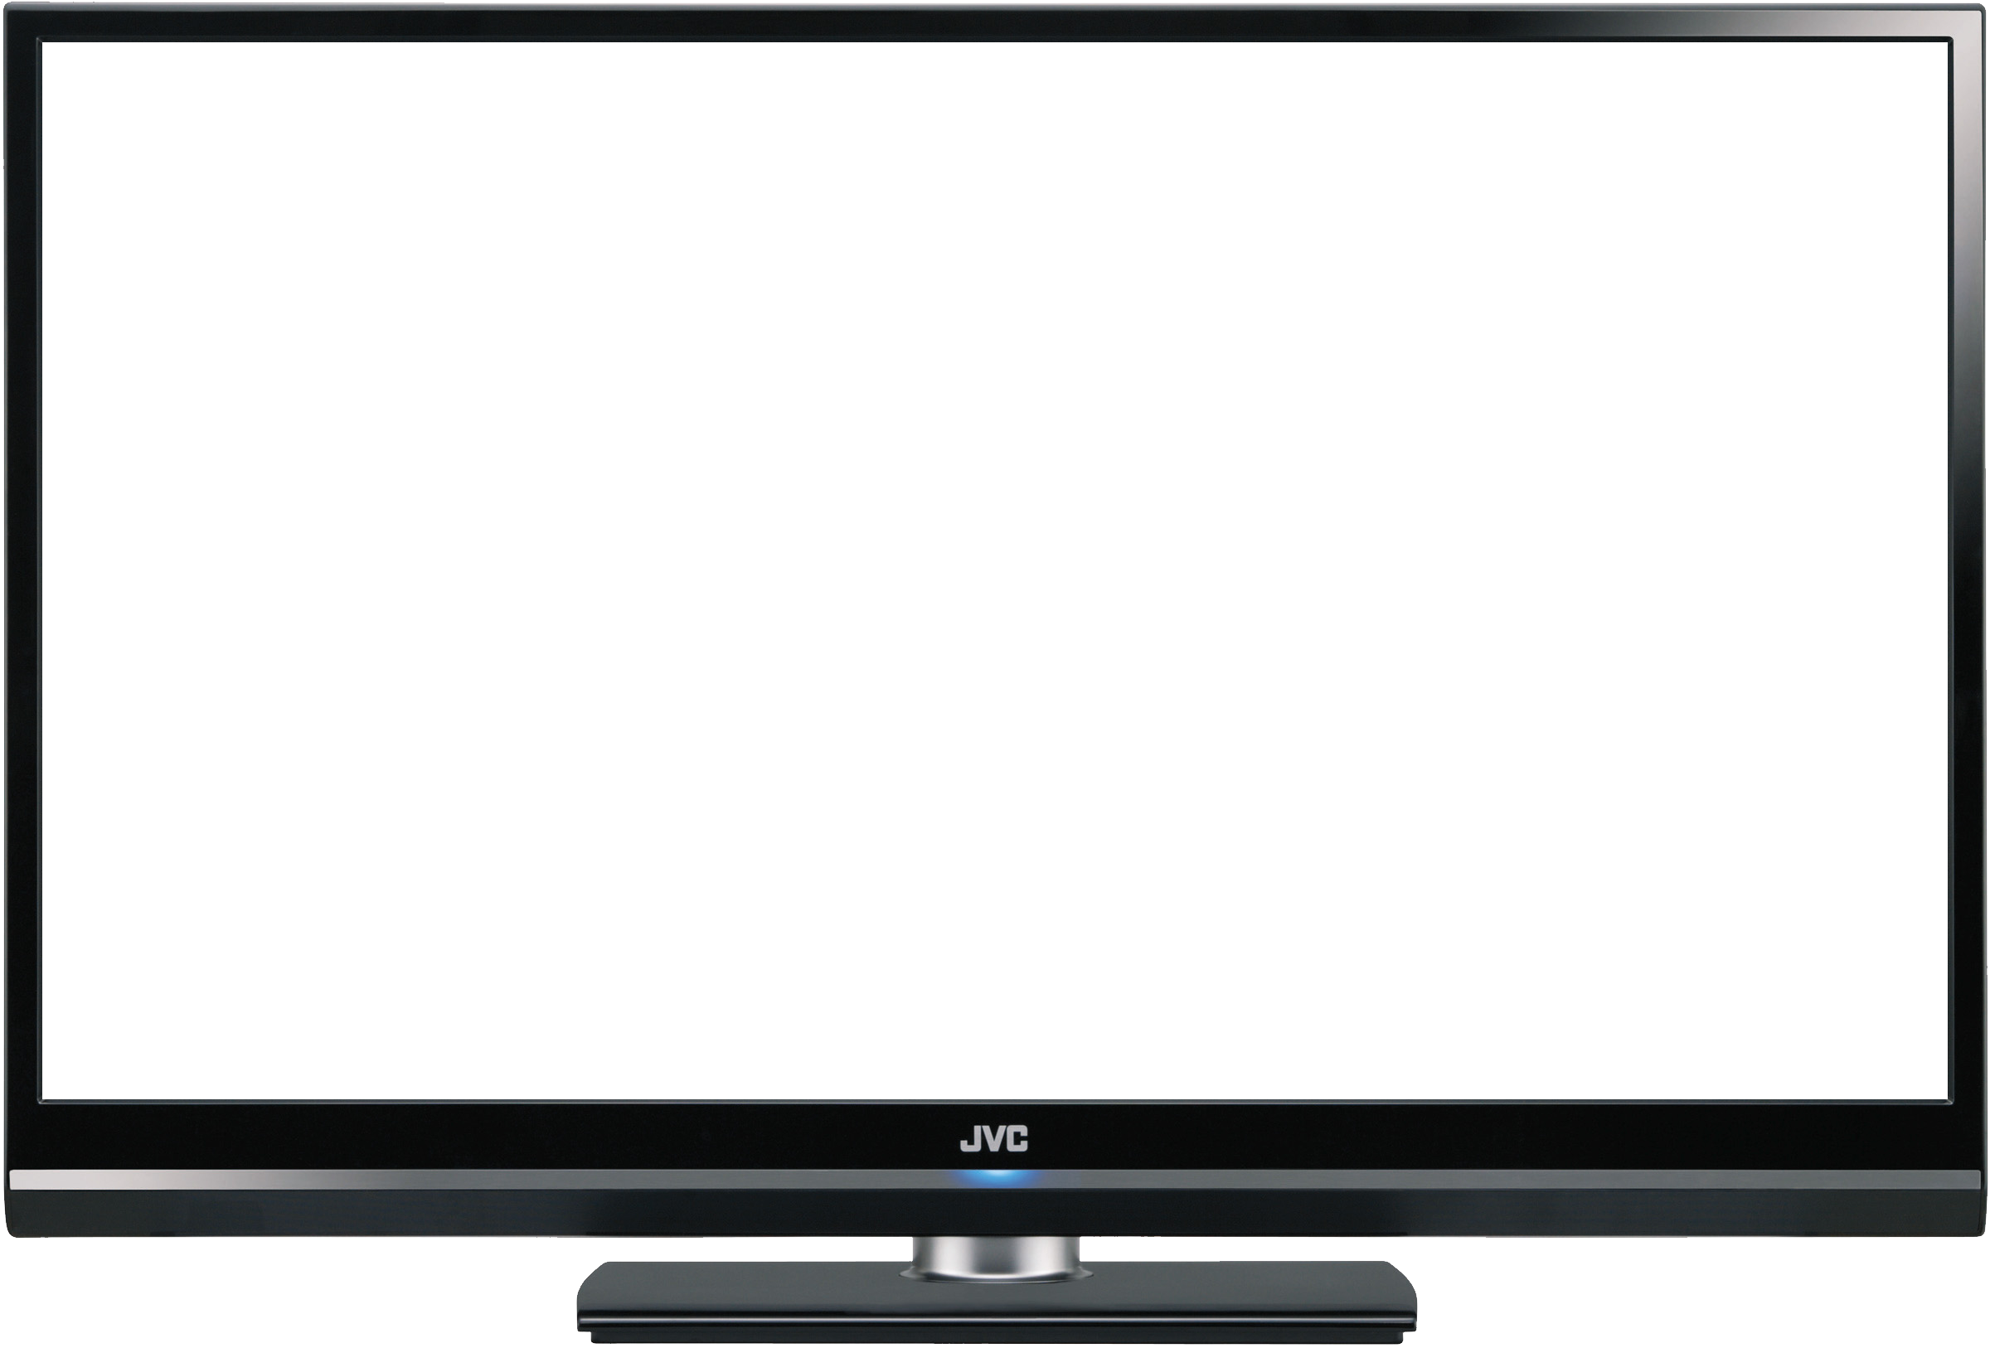

It is here….

Slide 12

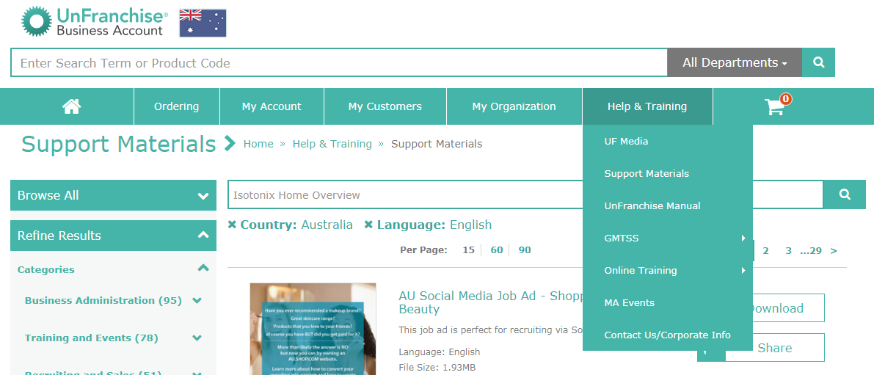
Download from our back office…
au.unfranchise.com

Slide 13

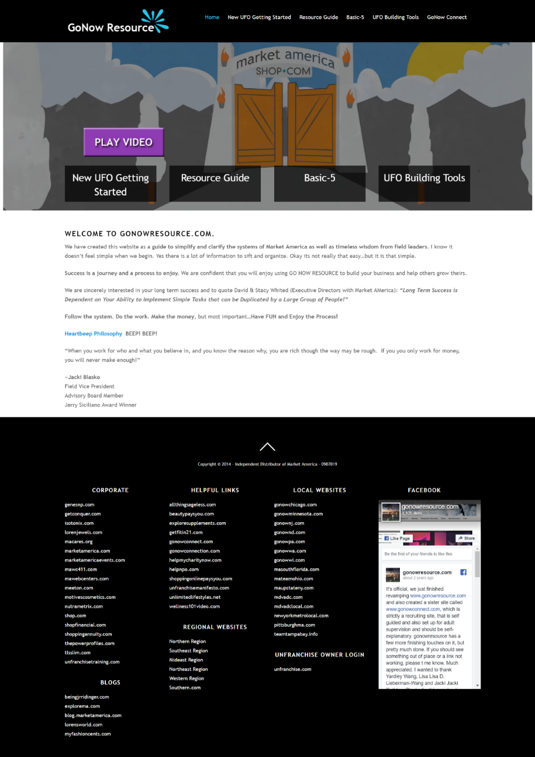

Visit….
www.GoNowResource.com
for more information and tools

Slide 14

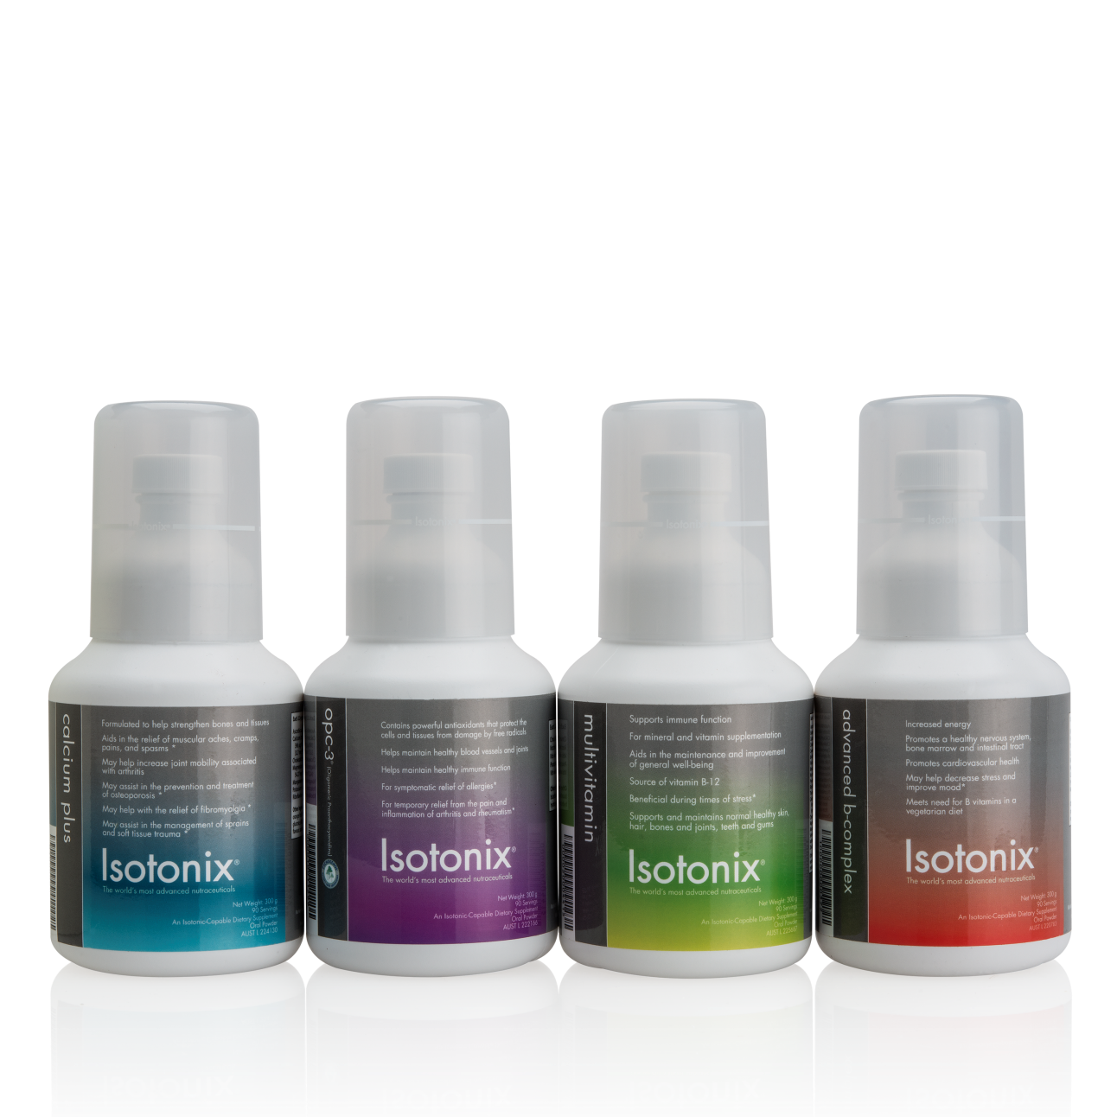
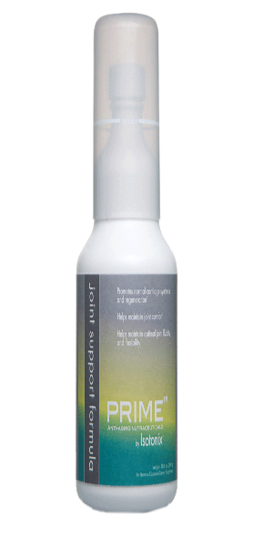


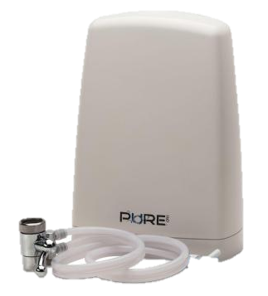
Products we focus on in
Wellness 101

Slide 15
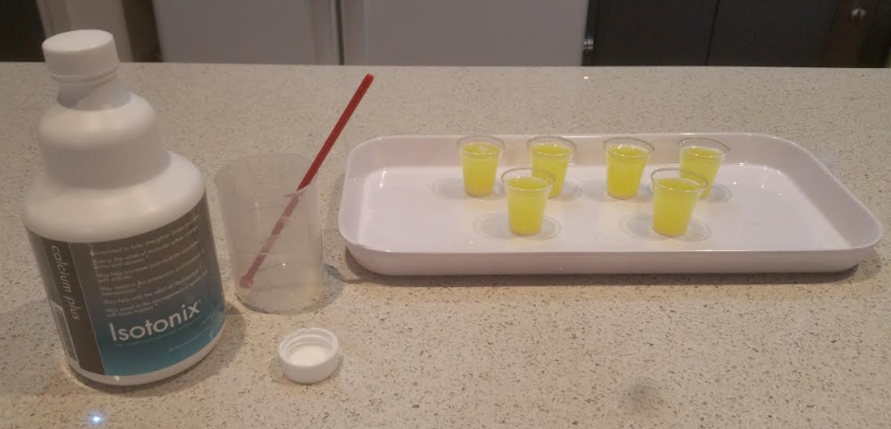
Product Tasting & Samplings

Slide 16
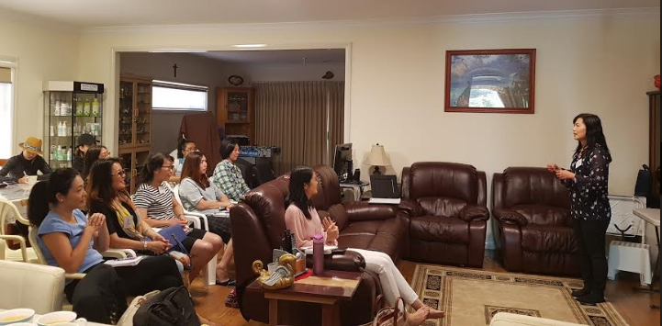
Share testimonies !!
Stories sell !!

Slide 17
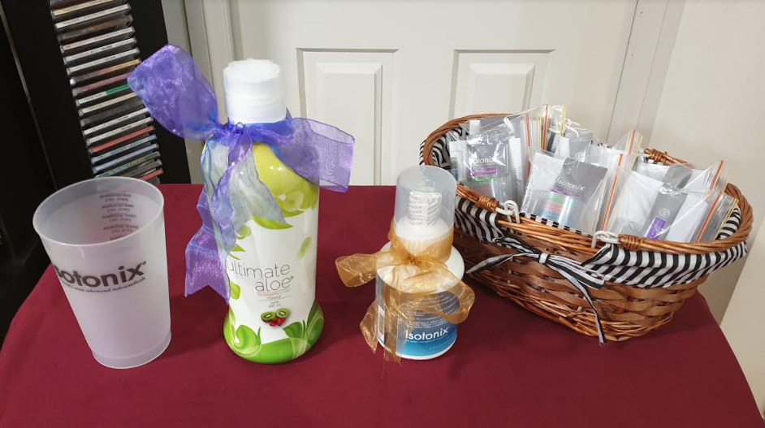
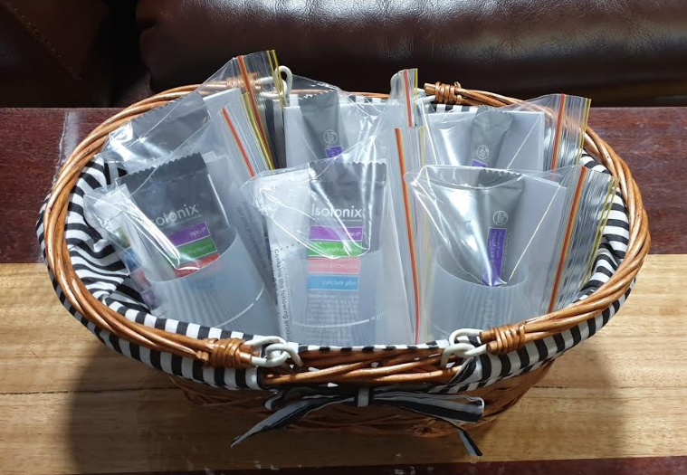
Lucky Draw
Samples to bring home
Daily Essentials Kit
Digestive Enzymes

Slide 18


The next step is….
Invite them to the next TLS Class
Building from Event to Event

Slide 19


Other Home events which can be related to Wellness 101….
Motives Workshops
Skincare Workshops
TLS Overview
Home Business Presentation

Slide 20
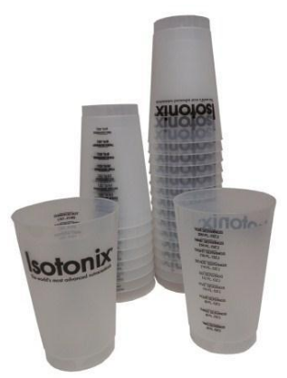

Close Sales & take orders…
10% OFF
FREE SHIPPING

Slide 21
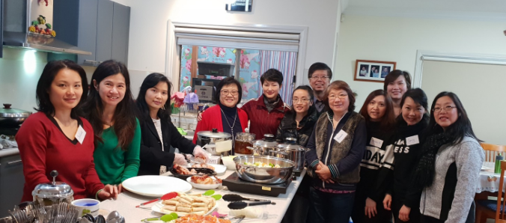
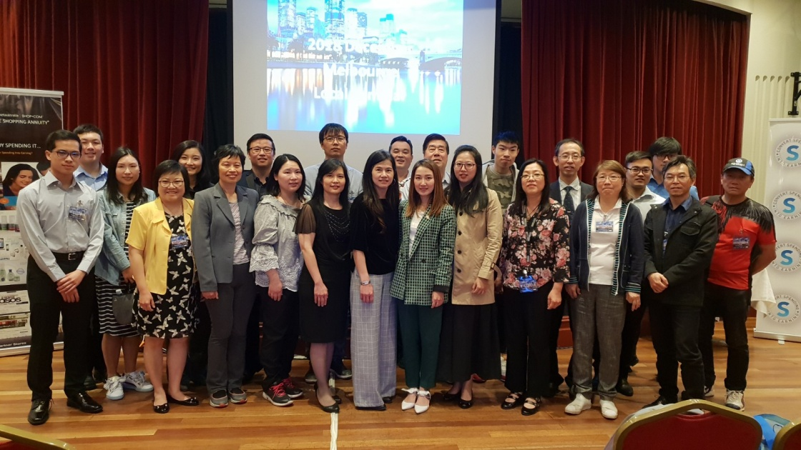
Wellness 101…
    grows BV ($$$)
    grows awesome TEAM!!!

Slide 22

Wellness 101 works!
Start one today!

